Slide 1
ON THE USE OF WIDEBAND SIGNAL FOR NOISE ROBUST ASR
Author : Dusan Macho & Yan Ming Cheng
Professor : 陳嘉平
Repoter : 楊治鏞

Slide 2
Outline
Introduction
Investigated approaches
Recognition experiments

Slide 3
Introduction(1/2)
The use of wider frequency range (wideband signal) in telecommunication applications is expected soon.
We consider that the wideband (w-b) signal ranges from 0 to 8kHz.
l-f (n-b) 0-4k | h-f 4-8K
w-b(0-8k)

Slide 4
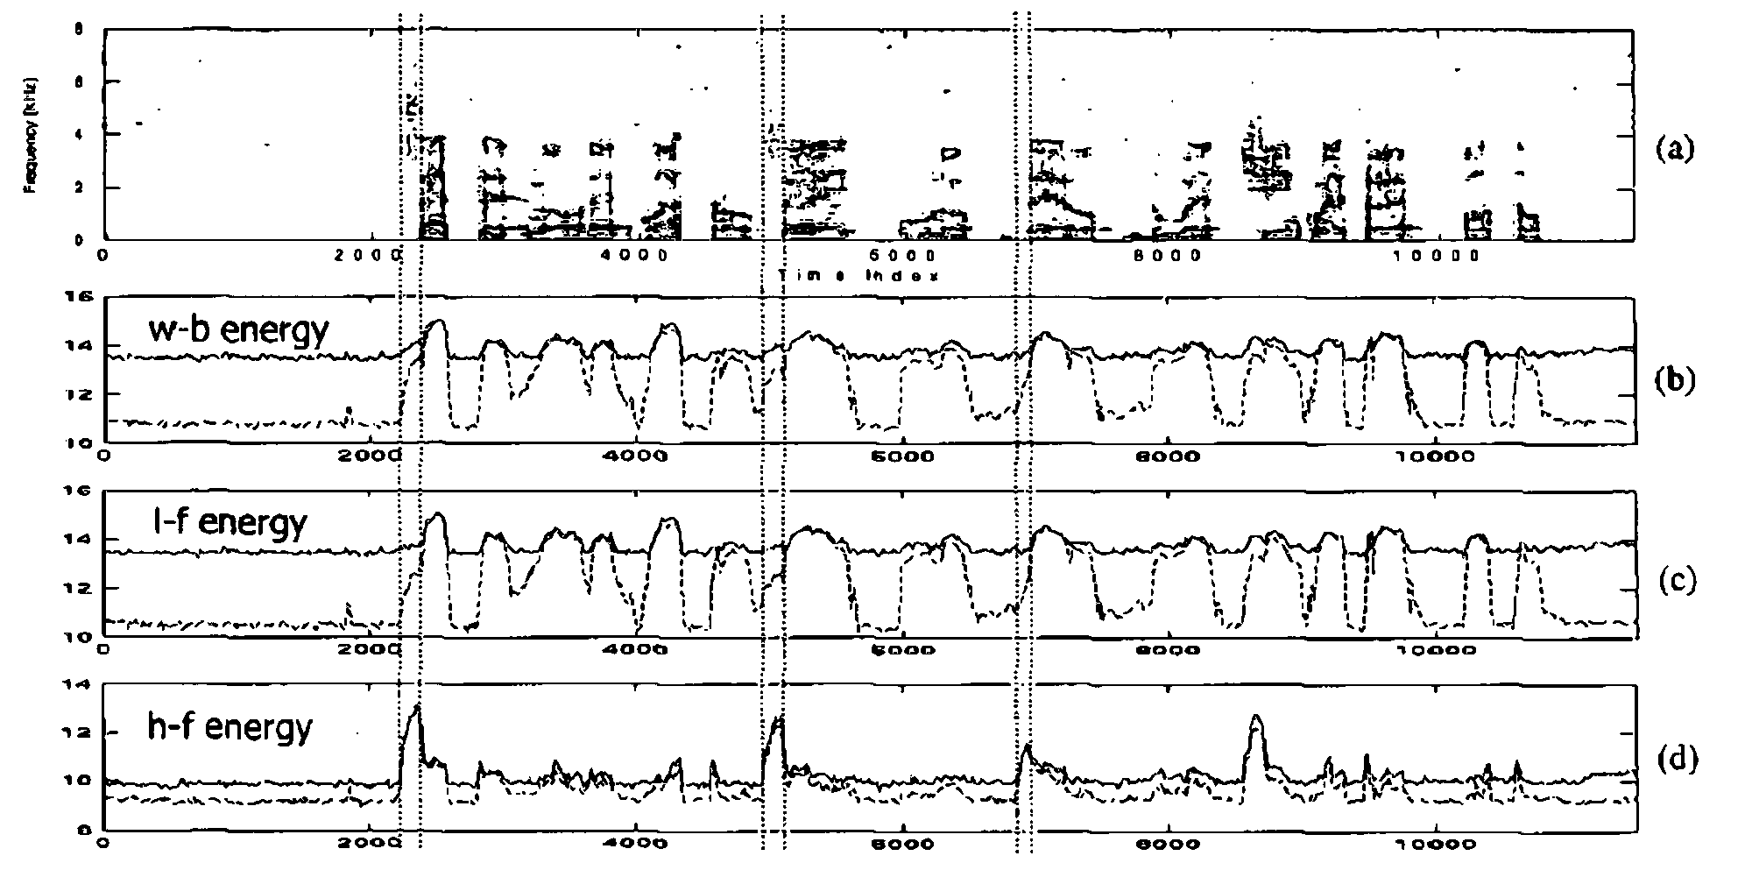
Figure 2
Wideband spectrogram of Italian digit sequence "sette nove quattro sei uno zero due cinque Ire otto" - close-talking microphone(a).

Slide 5
Introduction(2/2)
In the presence of noise, the combination of the I-f speech information, which is high-SNR, with the h-f speech information, which is low-SNR, would cause that the w-b speech features become more affected by noise than the n-b speech features.
Therefore, the benefit of adding the h-f speech information into the ASR speech representation is questionable when Considering noisy speech recognition.

Slide 6
Investigated approaches
When comparing Figures 2(b) and 2(d)
we can see that the identification of the h-f speech sounds in the case of low-SNR signal (solid lines) can be done much better from the h-f energy contour than from the w-b energy contour

Slide 7
Investigated approaches
a) the noise robust front-end designed originally for the n-b signal can be reused for processing of the I-f part of w-h signal
b) due to a relatively lower information content, the processing of the h-f part of w-h signal may be less complex than that of the I-f part

Slide 8
Description of approaches(1/3)
Both I-f and h-f parts of w-b signal are obtained by filtering the input w-b signal by a couple of quadrature mirror filters.
Basic concept is depicted in Figure 3

Slide 9
Description of approaches(2/3)
Log FB energies
h-f
4-8kHz
Spectrum
Estimation
Mel
Filter-Bank
h-f
Noise
Reduction
16kHz
signal
MFCC
features
l-f
0-4kHz
l-f
Noise
Reduction
Spectrum
Estimation
Mel
Filter-Bank
Cepstrum

Slide 10
Description of approaches(3/3)
use linear spectral subtraction(SS)
To minimize the mismatch, we apply an adjustment to the h-f filter-bank energies, which is based on an encoding/decoding scheme.

Slide 11
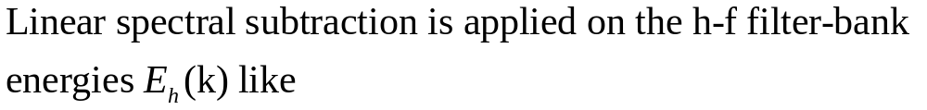
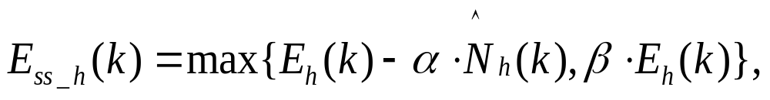

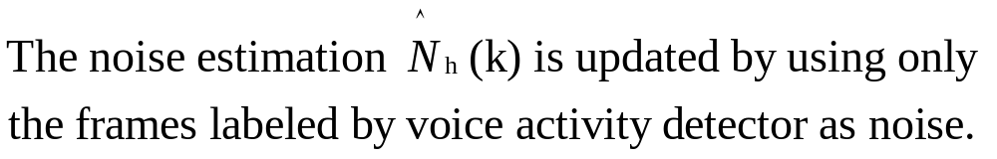
Spectral subtraction in h-f

Slide 12
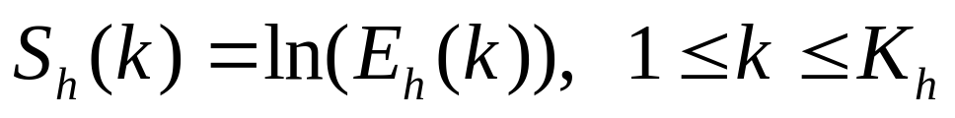
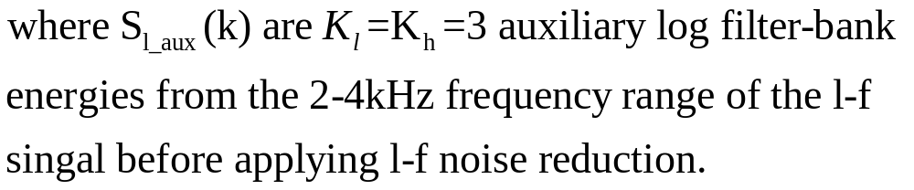
Encoding scheme in h-f

Slide 13
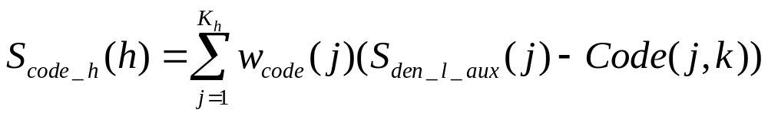
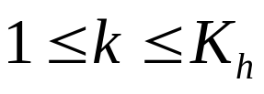
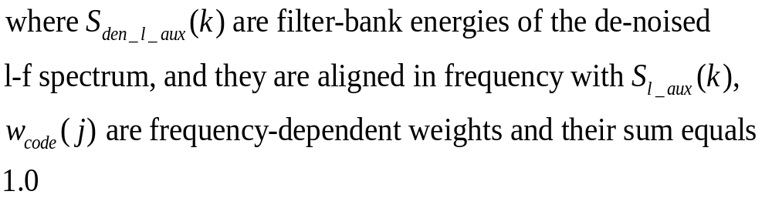
Decoding scheme in h-f

Slide 14
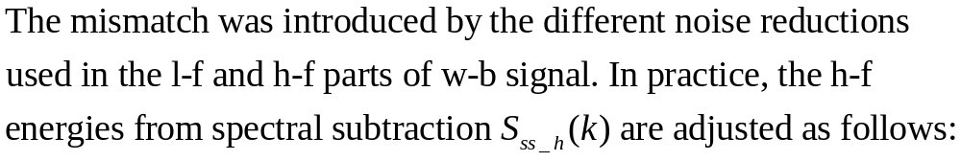
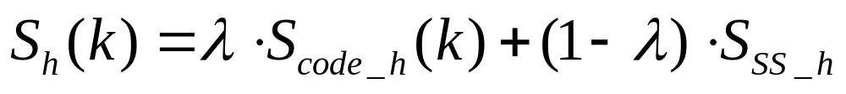
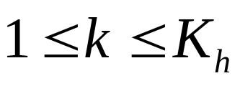
Integration of SS and E/D scheme in h-f

Slide 15
Recognition experiments
SpeechDat Car (SDC) digit databases
Spanish,Finnish,Danish,Italian
well-match (WM)
medium mismatched (MM)
highly mismatched (HM)
VAD

Slide 16
Experiment and results
8kHz and 16kHz data
window size change: 200 to 400
Window shift change:80 to 160
FFT order change: 256 to 512
Filter-bank bands:23 and 30
Number of static cepstral coefficients:12+

Slide 17
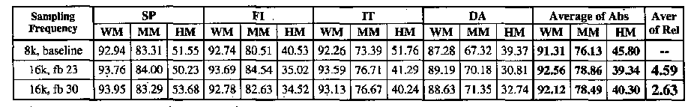
Table 1

Slide 18
Experiment and results 2
First approach, we tested the addition of the de-noised h-f log filter-bank energies to cepstral features. The best results were obtained by adding two h-f log energies.
In the second approach, three de-noised h-f log filter-bank energies were added to the 23 de-noised l-f log filter-bank energies.

Slide 19
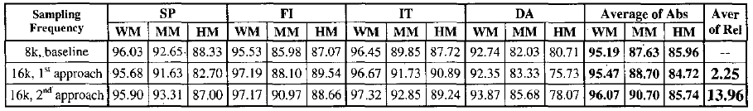
Table 2

